Slide 1


My Dose Coach as a
beyond-the-pill strategy

Slide 2

Beyond the Pill: How to Improve the Customer Experience in Pharma
"Despite the availability of new medicines for the treatment of diabetes, we see that outcomes are not sufficiently improving and that more than half of patients are not well controlled. With this in mind, Sanofi is focusing on a beyond-the-pill approach. We know that diabetes management is a 24/7 job, and we recognize that the right tools need to be developed to realize better outcomes.”
-- Peter Guenter, Executive Vice-President, Diabetes & Cardiovascular at Sanofi.
* THE VAST MAJORITY OF PATIENTS DON’T JUST WANT PATIENT SERVICES – THEY EXPECT THEM
76% of patients think companies have a responsibility to provide information and services that complement the product they sell.
74% of patients indicate that the most appropriate time to initiate outreach is when they start taking a medication.
50% of patients are open to receive assistance after they have begun a course of treatment or are considering switching.
*Accenture report. Photo credit to Stephan Klaschka
Notes:
At the forefront of this re-evaluation is the concept of going ‘beyond the pill’ – in other words, offering services that address stakeholder needs along the patient pathway, leading to better health outcomes while at the same time providing a source of competitive advantage and higher value to patients, physicians and payers.

Slide 3
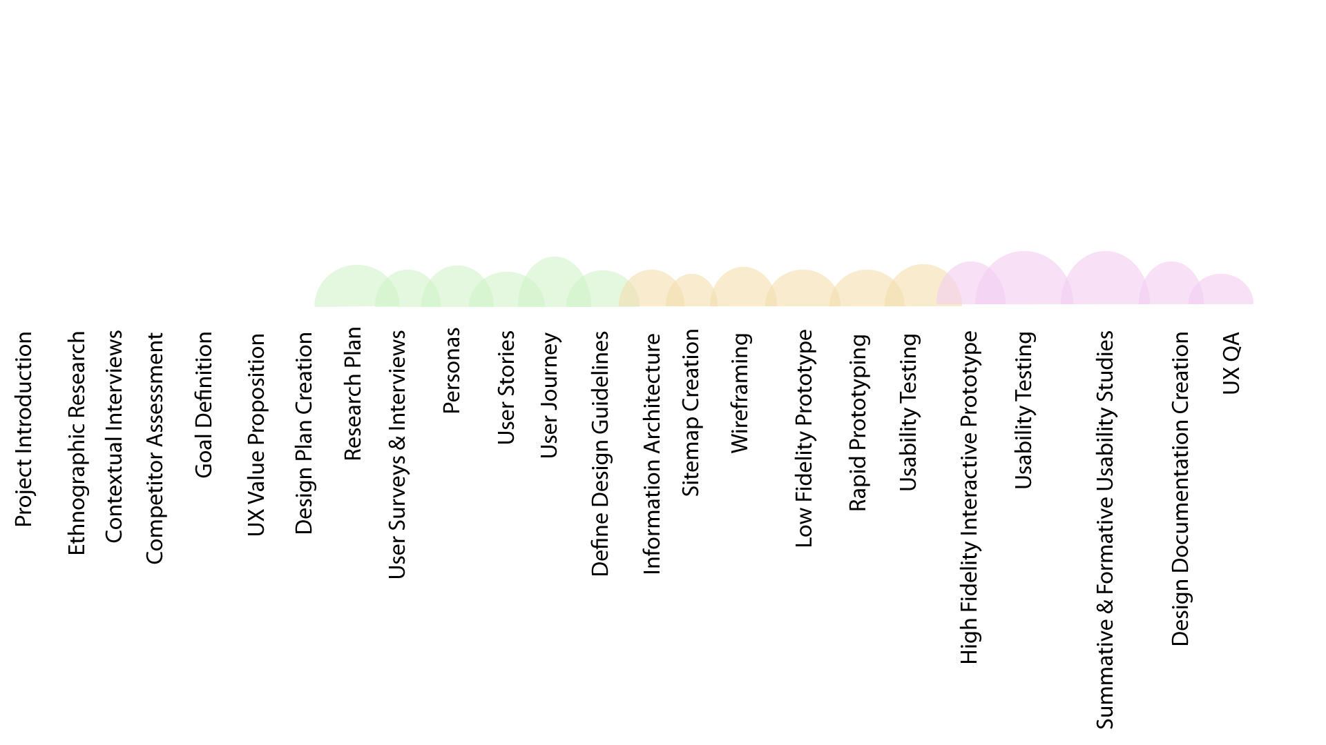
My Dose Coach UX Process
Notes:
Identifying user needs that have yet to be met
Testing market demand for products that do not exist
Providing a holistic view of a problem space
Exposing opportunities for competitive differentiation

Slide 4
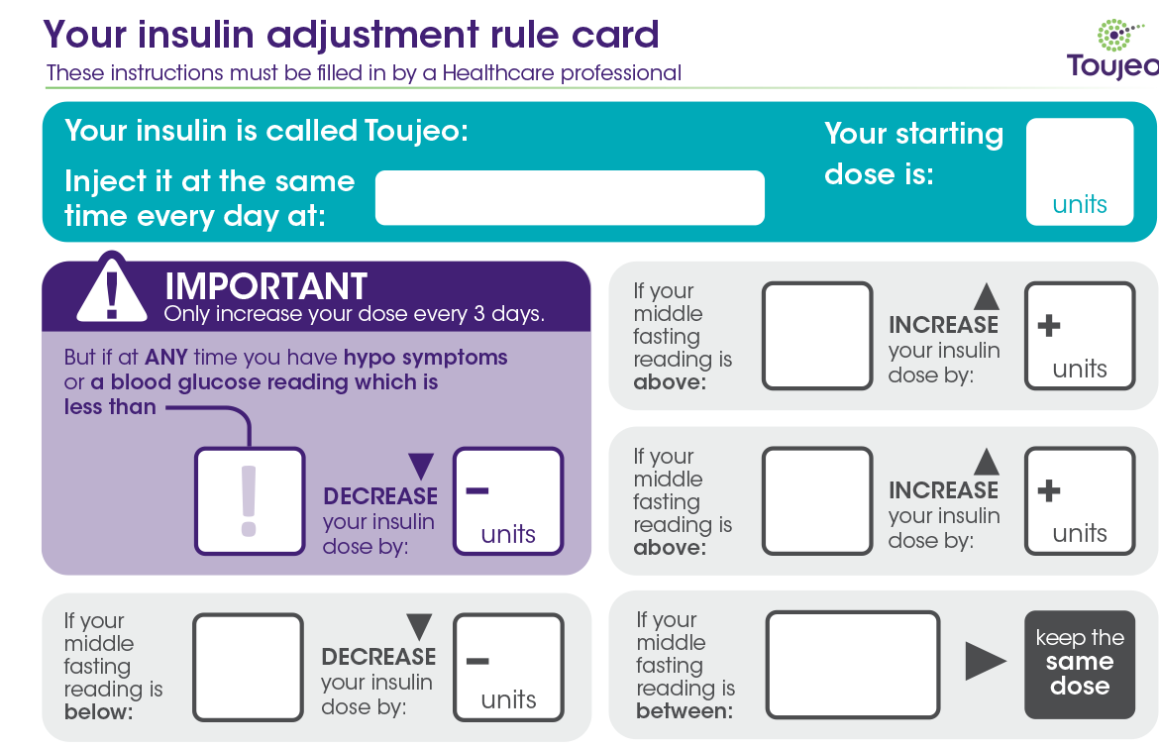
… and we get started
Paper-based insulin basal titration, combined with clinical inertia driven by a lack of knowledge, education and time, resulted into poor adherence to basal insulin therapy by people with diabetes, patient outcomes and safety; as well as healthcare providers work workflow efficacy.
Metrics
Patients
Time to target
FBG volatility
Drop-off rate of titrating patients
Dose adherence
# of hypos and hypers
Adoption rate
Success rate
Error rate
HCP
The time a task requires to create Dose Plan
HCP interventions
Adoption rate
Success rate
Error rate
Goals
Digitize titration process for T2D by offering services that addresses stakeholder needs along the patient pathway.
Provide a source of competitive advantage and higher value to patients, physicians and payers.
Provide patient-centered insulin initiation regimen that improves communication between providers and patients and increase medication adherence.
Engage patient in their diabetes self-management and empower them with knowledge about their disease.
Provide easy to use and access tool for HCPs to increase workflow efficiency.
Ease patients barriers associated with insulin initiation.
Improve patient safety.

Slide 5

They talk about all these different numbers which mean nothing to you, HABC1 and God knows what, and I thought oh this is like algebra here!
(Patient – UK)

Slide 6

Key solution conceptual components of my Dose Coach Platform

Slide 7
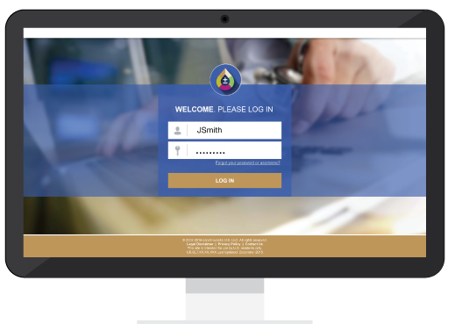
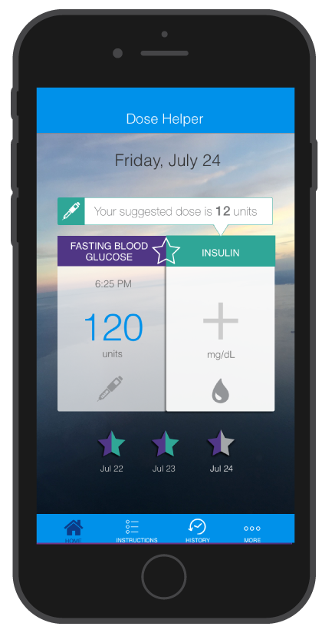

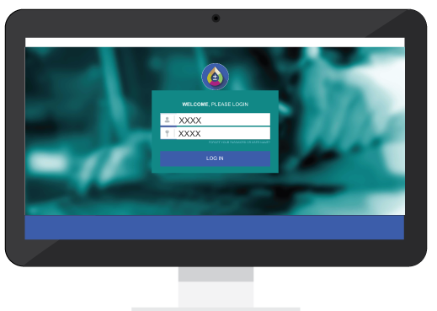
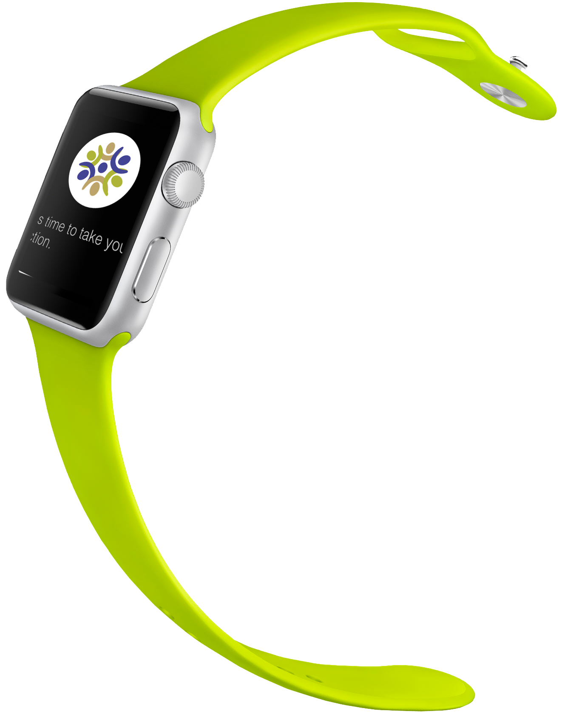
my Dose Coach System Overview
HCP/Care Team Portal
- Patient creation and mgmt
- Dose plan creation and mgmt
- Access to Patient entered data
- Clinic Mgmt
- Patient privacy/security
Patient Application
FBG/Dose entry
Dose suggestions based on custom dose plan
Reminders & notifications
myDose Coach Cloud
Administrative Portal
Clinic Creation
Support
Wearables
- Suggesting dose
- Firing reminders.

Slide 8
MyDose Coach
Research types during project duration
Few Initial Research Objectives
Explore the experiences and perceptions of patients and HCP during the early phases of insulin initiation and titration
Understand how patients and HCPs experience titration over time
Uncover how and why patients are involved in treatment decisions
Identify sources and patterns of information-seeking
Reveal gaps in knowledge and experience
Identify and understand the emotional drivers of decision-making and treatment
Gain insight into challenges and barriers patients and HCPs while titrating
Understanding roles of NP/PA CDE in insulin initiation and titrating, and the extent to which hypoglycemia is a concern as well as patient education and training
Ethnographic | Card Sorting
Contextual Interviews | Usability Testing
Focus Group | A/B Testing
Surveys | Targeted Interviews (e.g. My Dose Coach EMR integration)
Formative & Summative Studies | Picture Gallery

Slide 9


MyDose Coach
Research was conducted with health care providers and patients in the US, France, Italy, the UK and China.
Total: 89 Patients and 95 HCPs
Surveys
Photo Gallery (part of interviews and surveys)
  New York
  Miami
  Indianapolis
89 Patients: 60 min interviews
• T2D (male & female, mix of ages, time since diagnosis)
• Basal insulin initiation within past 6-24 months
95 HCPs: 90 min mini-groups (2-3 per group)
• Board certified and treat Type 2 Diabetes
• In practice 3 to 30 years
• Spend 70%+ of time in direct patient care
• Prescribe and train T2D patients on insulin therapies and titration
*HCP interviews in China were conducted as individuals to eliminate potential bias introduced by cultural norms experienced in group settings.
29 Patients 13 Endos 13 PCPs 12 Nurses
  London
  Paris
  Milan
45 Patients 18 Endos 6 PCPs 18 Nurses
  Shanghai
174 NP/PA and CDE. Location: USA. Source: Idea Exchange Cloud
45 Patients 18 Endos 6 PCPs 18 Nurses

Slide 10
MyDose Coach
One—Page executive summary
  Patients often associate insulin with complications, such as amputation or weight gain, and failure to manage their disease; as a result, they adopt tactics to delay starting on insulin
  Patients are incorrectly titrating their insulin, often due to physicians not having the time or language to communicate effectively and patients simply not understanding what to do
  Patients fear both injection and titration, with concerns over hypoglycemia resulting in under-titration
    Where to inject? / How to inject?
    When to inject? / Amount to inject?
  Patients are often scared to discuss their failure to follow instructions (in testing and/or dosing their insulin) for fear of being reprimanded
  45% patients within 3 months dropouts while titrating
  HCP’s inertia
  Physicians are overburdened and lack sufficient time to spend with patients that results into patient’s misunderstanding of the process
  Physicians see themselves as decision-makers and not as educators – often leaving education to their nursing staff
  HCP view the titration algorithm as too complex for patients to understand
  Tailored solutions that can be delivered by nurses will have the greatest chance of success
  Tailored instructions and support materials for patients are needed
  Remote monitoring is great for nurses, however concern with legal ramification, that's why nurses and CDE are mostly likely target users of this feature
  Common fear of hypoglycemia amongst patients and HCP results into undertitration

Slide 11




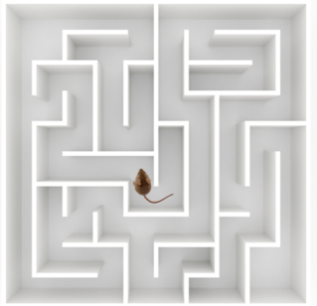

Picture Gallery Results – PCPS
You weigh up the pros of going on insulin versus not going on insulin and discussing that and trying to persuade the patient, because patients are almost invariably anti-insulin.
(PCP – UK)
I think this is reflected the control of diet of the patients. I still want it to be a balanced diet. This is what I encourage, this is a cucumber, these is tomato, so I think this is good for the patients. (PCP – China)
A journey. Whether they are just diagnosed or going on basal insulin… the first step there are multiple challenges. It’ll be a process.
(PCP – US)
When you start insulin you never stop it, it goes into the depth of the patient but the patient is going to be on it for the rest of his life, it will be related to his joy to live and the person will be tired and will have the complications of diabetes for life.
(PCP – France)
It’s going to be complicated to manage, for the patient to manage the insulin and the blood glucose levels. To try and understand how they are going to be able to titrate them and plan their meals for them, it’s a real problem, a puzzle.
(PCP – France)
It’s an uphill struggle for me, but I guess for them too because it’s just accepting, you know, it’s the barrier, God knows what the barrier is, but they do find injections of insulin a barrier.
(PCP – UK)

